Slide 1
Guide to the library catalogue MENDELU

Slide 2
Where to search?
katalog.mendelu.cz

Slide 3
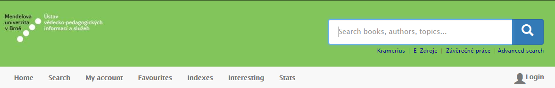

Quick search tool
Enter title, name or key words.
Advanced search by type, year, location etc.

Slide 4
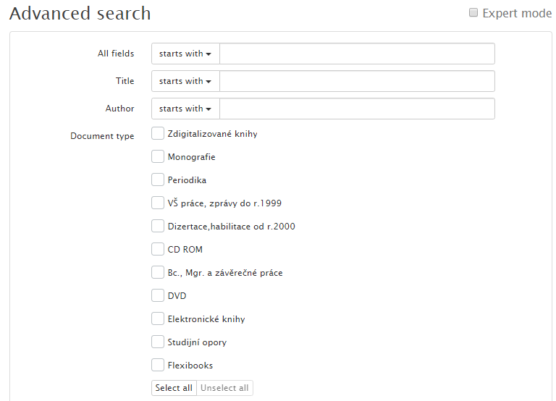
TIP!
Search by title or surname of the author.
TIP!
Select the type of document.

Slide 5
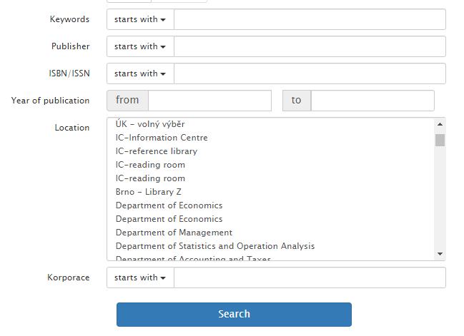
LIBRARY TIP!
Select required location, e.g. Central Library (UK).

Slide 6
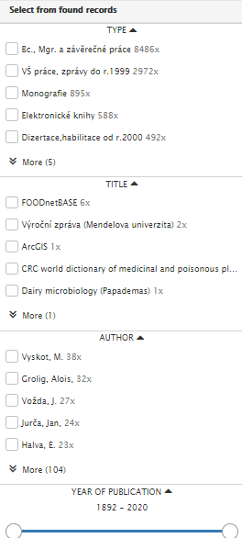
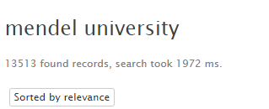
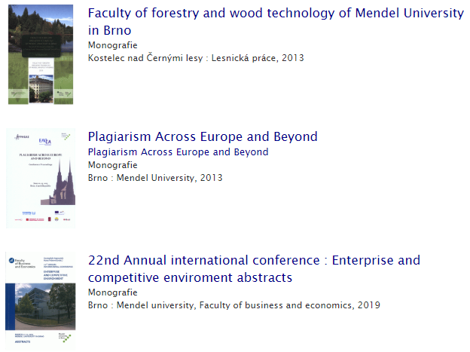
Results for key word „Mendel university“
Found results can be filtered.

Slide 7
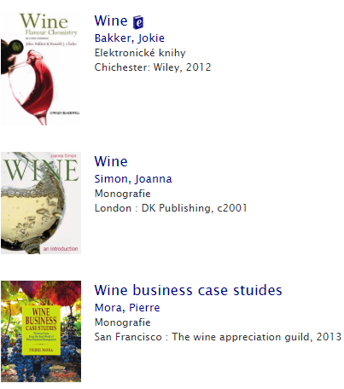
To open the record, click on the title.

Slide 8
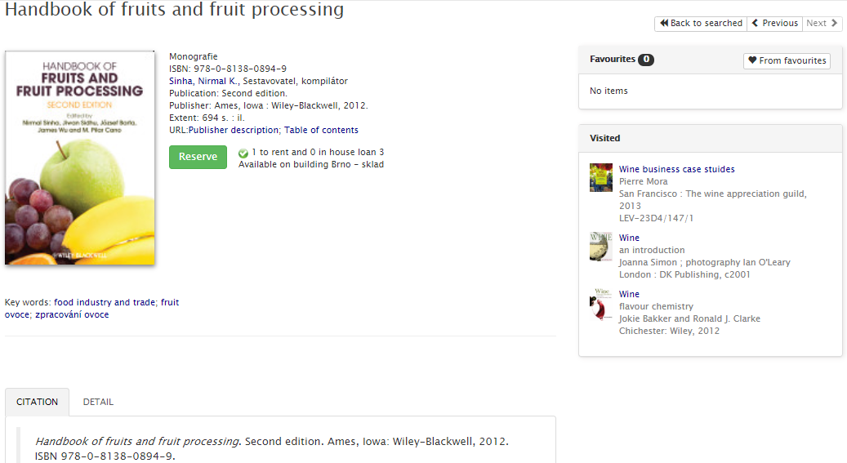
TIP!
Citation from citation tool CitacePRO.

Slide 9
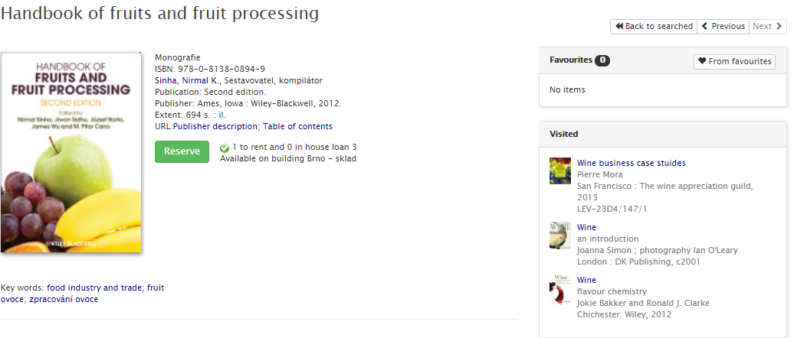
Where can I find it?
Scroll down for details!

Slide 10
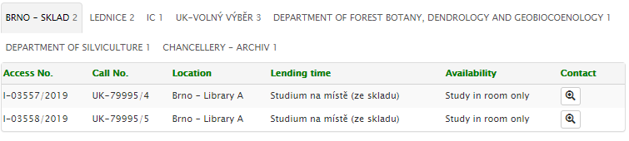
List of locations, where the book can be found.

Slide 11
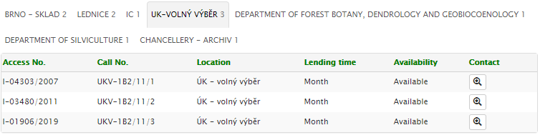
Where to find the book and how to borrow it?
ÚK-Volný výběr:
The copy is located in the Central Library, building A, in open shelves.
Note the call number. The book is located on the shelf with by this number.
The item can be borrowed for 30 days and renewed twice.
Check the availability.

Slide 12
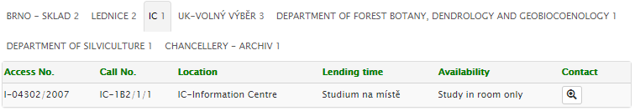
Where to find the book and how to borrow it?
IC:
The copy is located in the Information centre building A.
Note the call number. The book is located on the shelf with by this number.
This item cannot be borrowed outside the Information centre.

Slide 13
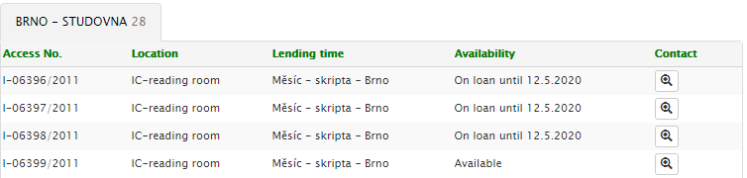
Where to find the book and how to borrow it?
Brno-studovna:
The copy is located in the Central Library, building A, in the study room with textbooks.
They sorted in alphabetic order.
The item can be borrowed for 30 days and renewed twice.
Check the availability.

Slide 14
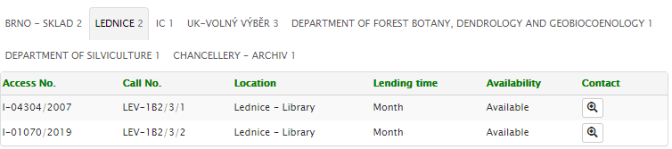
Where to find the book and how to borrow it?
Lednice:
The copy is located in the library of faculty of horticulture in Lednice, in open shelves.
Note the call number. The book is located on the shelf with by this number.
The item can be borrowed for 30 days and renewed twice.
Item availability

Slide 15
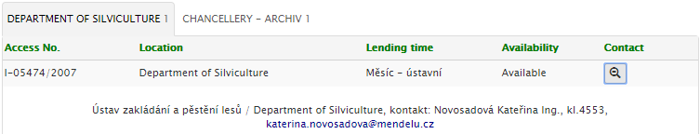
Where to find the book and how to borrow it?
The item is available at department library.
Click on the magnifier and contact the librarian for borrowing the book.

Slide 16
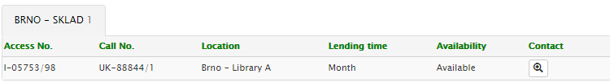
Where to find the book and how to borrow it?
The item can be borrowed for 30 days and renewed twice.
The item is stored in the library stock. Order it in the catalogue.

Slide 17
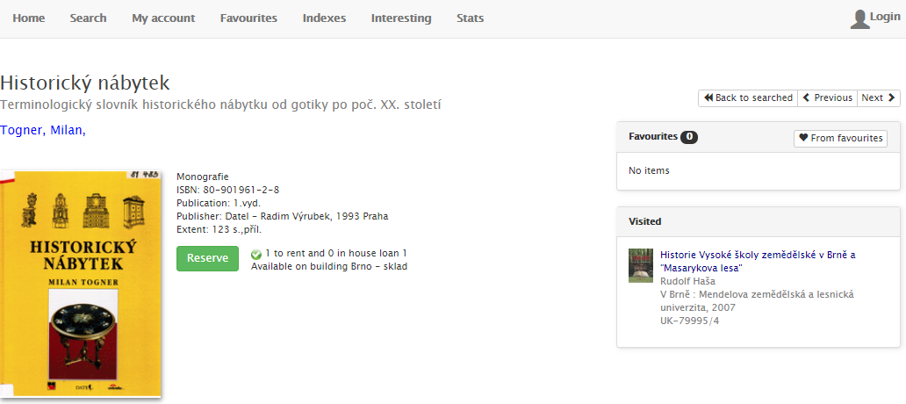
Ordering books from the library stock?
Log in to your catalogue account with you UIS details.

Slide 18
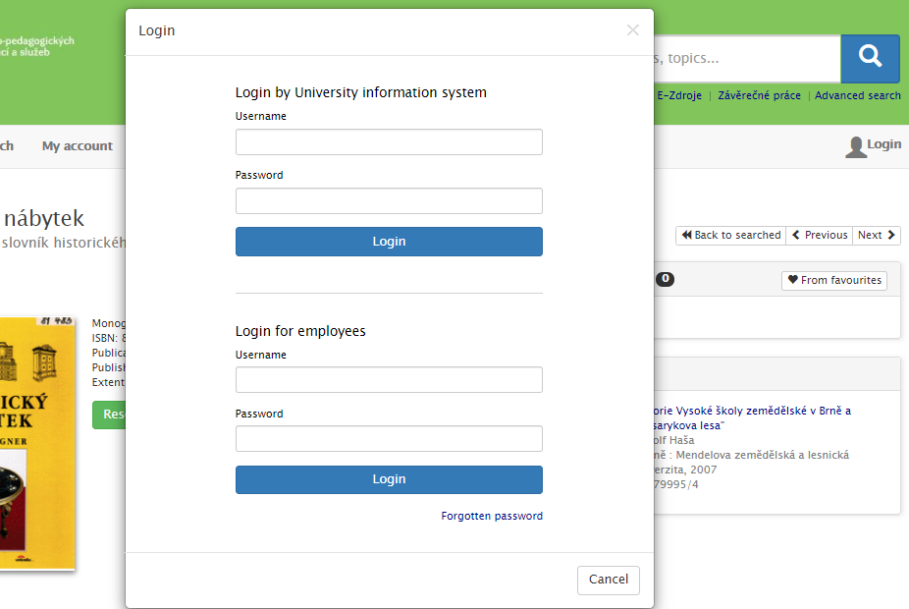

Slide 19
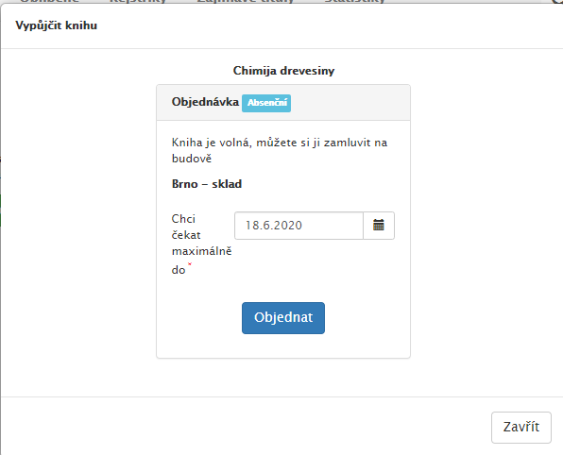
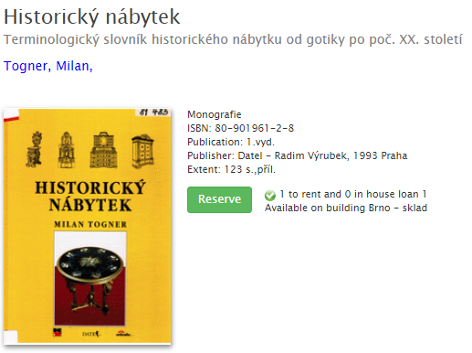
Confirm the order. You can also select the date for how long you are interested in this book.
The item will be prepared to pick up in the Central library.
After logging in, click on the green button to order the book.

Slide 20
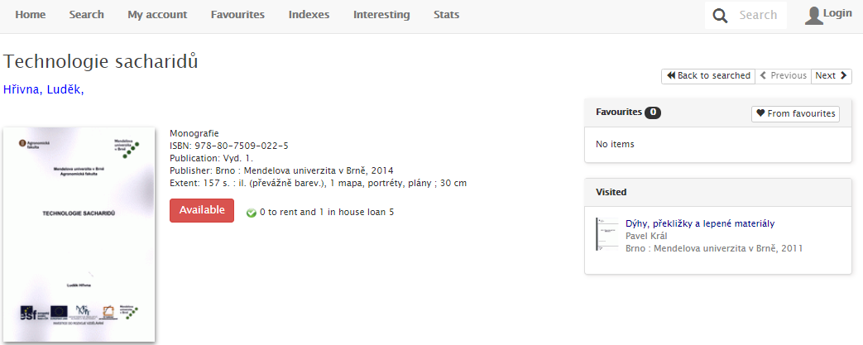
All items are taken – whar can I do?
Log in to your catalogue account with you UIS details.
All items are taken.

Slide 21
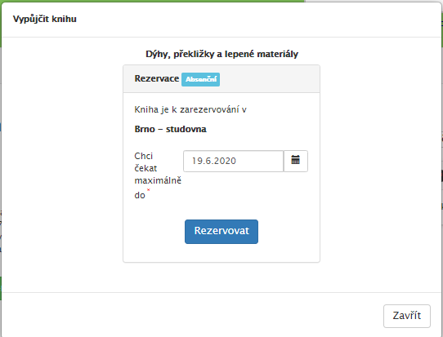
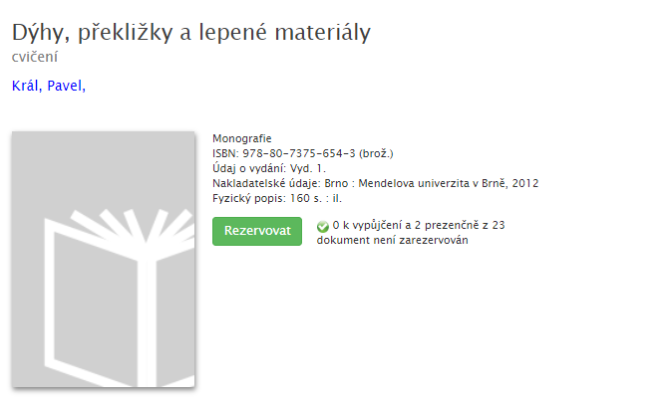
Choose how long you are willing to wait for the book and wait for the e-mail informing the reservation is ready.
You can chcek you reservations in your reader's account.
Click on the green button to reserve the book.

Slide 22
Where can I see my loans and due dates?
katalog.mendelu.cz

Slide 23
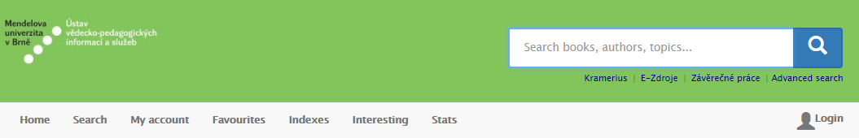
Log in to your catalogue account with you UIS details.
Your loans and due dates are under this tab.

Slide 24
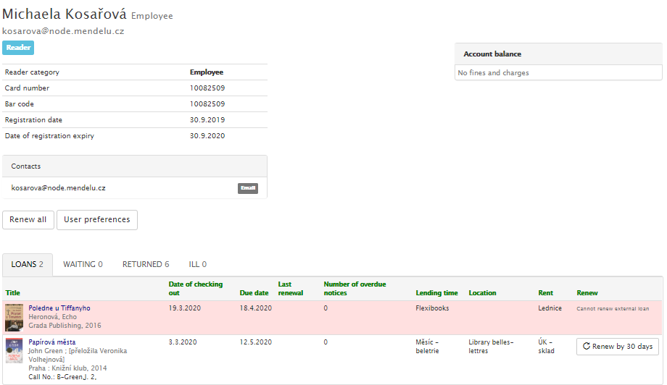
Fees for late returns is showing here.
Viktor Bažant
Reservations and orders can be found here.
55 Kč
This tab show items borrowed via Interlibrary loan service.
Due date for returning or renewing loans.
Here is list of your loans.

Slide 25
Viktor Bažant
The loan cannot be renew anymore, it must be returned to the library.
Renewing all loans, which can be renewed by the library rules.
Items can be renewed by 30 days from todays day.

Slide 26
Send your questions or purchase suggestions to
katalog@mendelu.cz

